Slide 1

Fostering fruitful
scientific collaborations
Co-ed mentoring group, September 2020

Slide 2
Outline
The innate complexity of the human nervous system.
Joining forces of researchers with diverse perspectives and expertise to achieve challenging goals (e.g. Human genome project, Eyewire etc.).
Reduce duplication of effort.
Take some of the heat out of hyper-competition.
Growing needs for interplay between experiment and theory.
Translational application from bench to bedside.
More funding opportunities through joint ownership of research projects with the ability to submit NIH grants as co-PIs.
Creating an enriched intellectual and social environment for trainees (e.g. joint lab meeting, journal club, retreat etc.).
Standardization and reproducibility (The International Brain Laboratory).
Notes:
What are some other motivation for collaboration especially for young investigators at our career stage?

Slide 3
Motivation for collaboration
The innate complexity of the human nervous system.
Joining forces of researchers with diverse perspectives and expertise to achieve challenging goals (e.g. Human genome project, Eyewire etc.).
Reduce duplication of effort.
Take some of the heat out of hyper-competition.
Growing needs for interplay between experiment and theory.
Translational application from bench to bedside.
More funding opportunities through joint ownership of research projects with the ability to submit NIH grants as co-PIs.
Creating an enriched intellectual and social environment for trainees (e.g. joint lab meeting, journal club, retreat etc.).
Standardization and reproducibility (The International Brain Laboratory).
Notes:
What are some other motivation for collaboration especially for young investigators at our career stage?

Slide 4
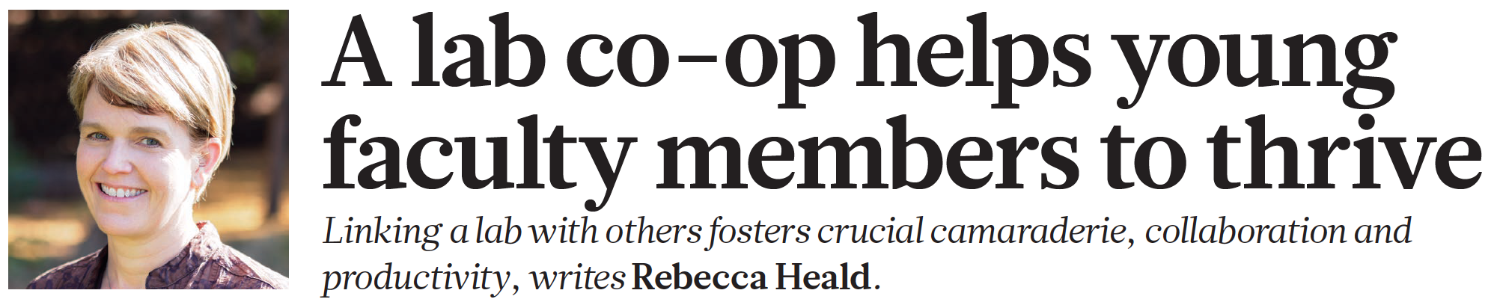
A Lab co-op by three PIs (The Trilab).
Sharing resources.
A joint lunch room.
Weekly joint lab meetings.
Close colleagues to bounce ideas around.
A tight network of colleagues facilitates collaboration.
Emotional support was just as important.
The biggest challenge is finding the right colleagues.
Even when forming a co-op is impractical, the mindset behind it improves health of individual labs.

Slide 5
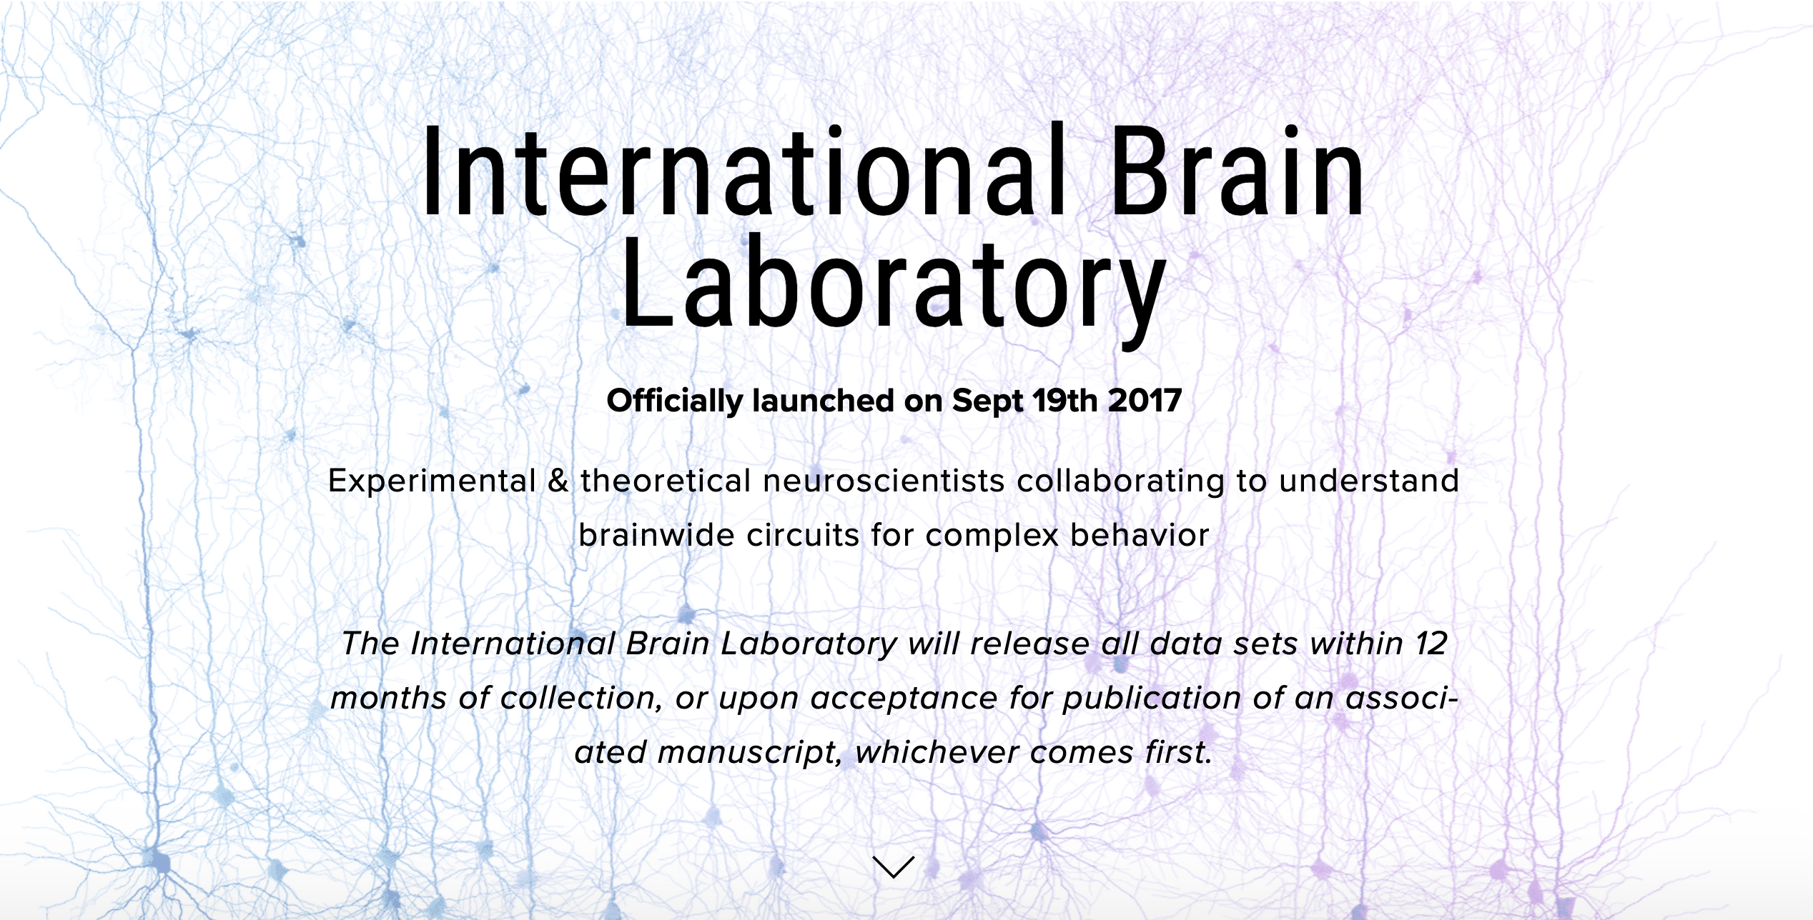

Slide 6
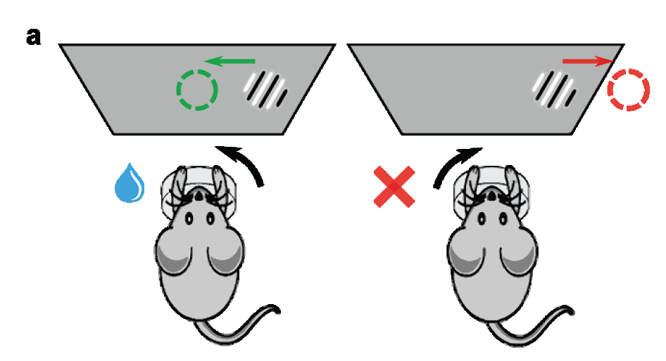
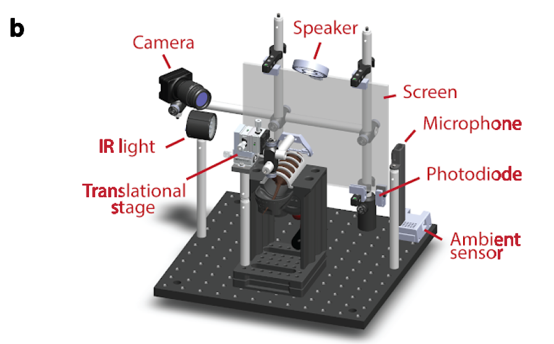
The IBL tackles on the scientific question of the neural basis of decision making.
A shared operationalization and experimental implementation of a perceptual decision making.
Emphasis on …
Standardization and reproducibility of experiments and data.
Open-sourcing and data sharing.
Close collaboration between experimentalists and theorists.
The International Brain Laboratory, 2020

Slide 7
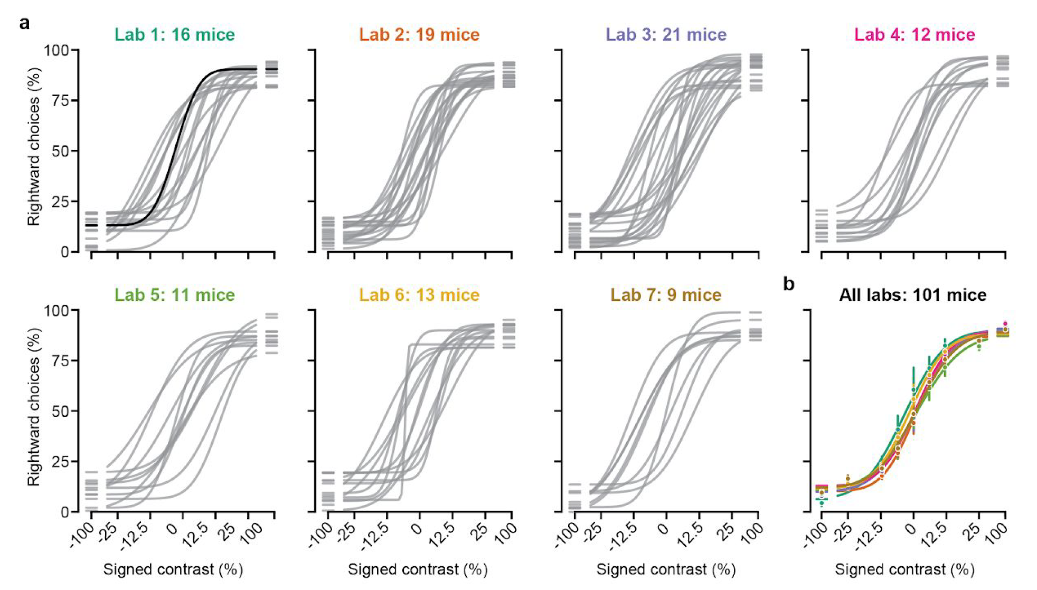
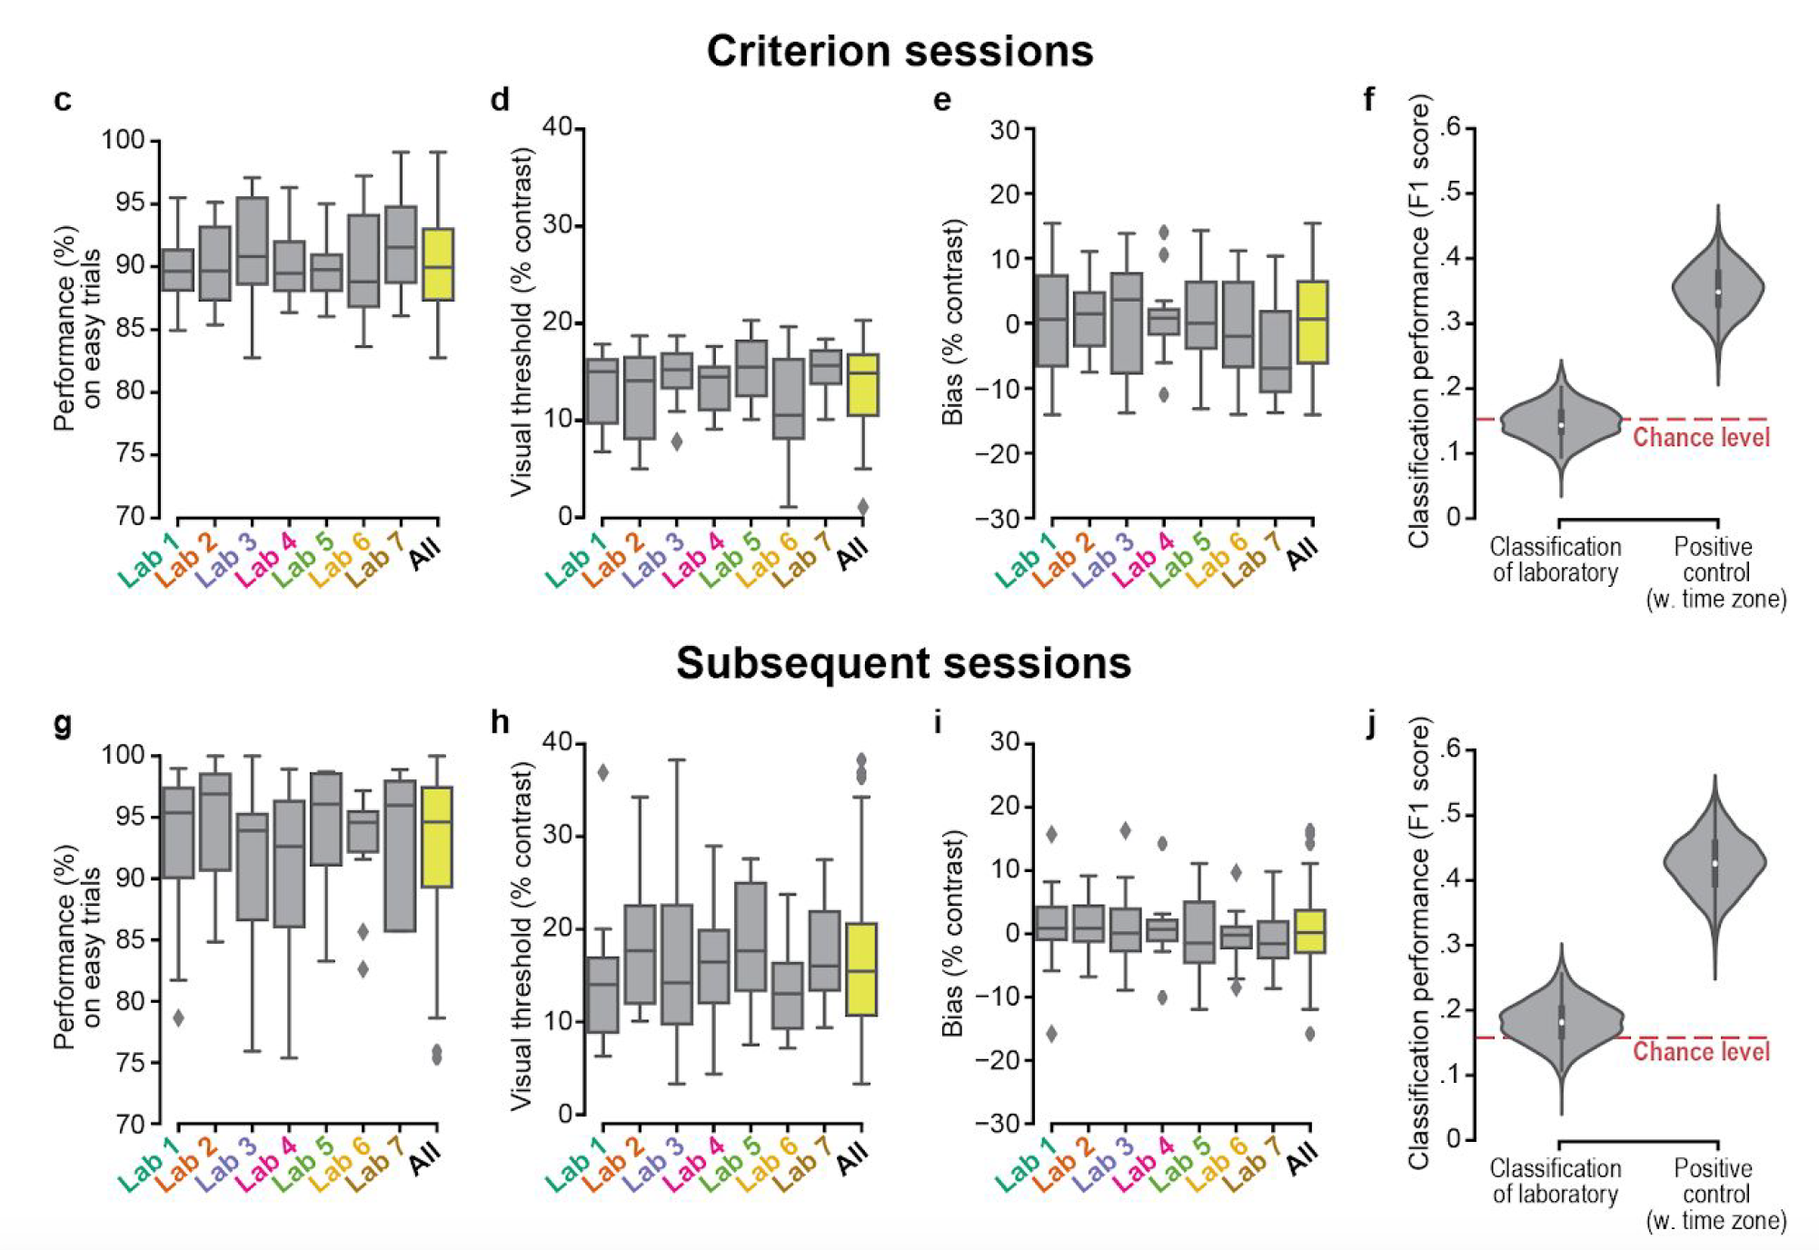
The IBL tackles on the scientific question of the neural basis of decision making.
A shared operationalization and experimental implementation of a perceptual decision making.
Emphasis on …
Collaboration between experimentalists and theorists.
Standardization and reproducibility of experiments and data.
Open-sourcing and data sharing.
The International Brain Laboratory, 2020

Slide 8
Discussion about how to work together
Self- and team-awareness (personalities, tendencies, strengths/weaknesses etc.).
Explicit delineation of expectations, roles and responsibilities are critical to build trust.
Clarify a shared vision and help members understand how their roles are connected to the vision.
Delineated agreement on sharing recognition and credit.
Criteria for authorship, publicity and how intellectual property and patent applications will be handled.
How to promote the careers of junior colleagues and investigators.
Communicating about science: promoting disagreement while containing conflict.
Conducting regular assessment and feedback sessions.

Slide 9
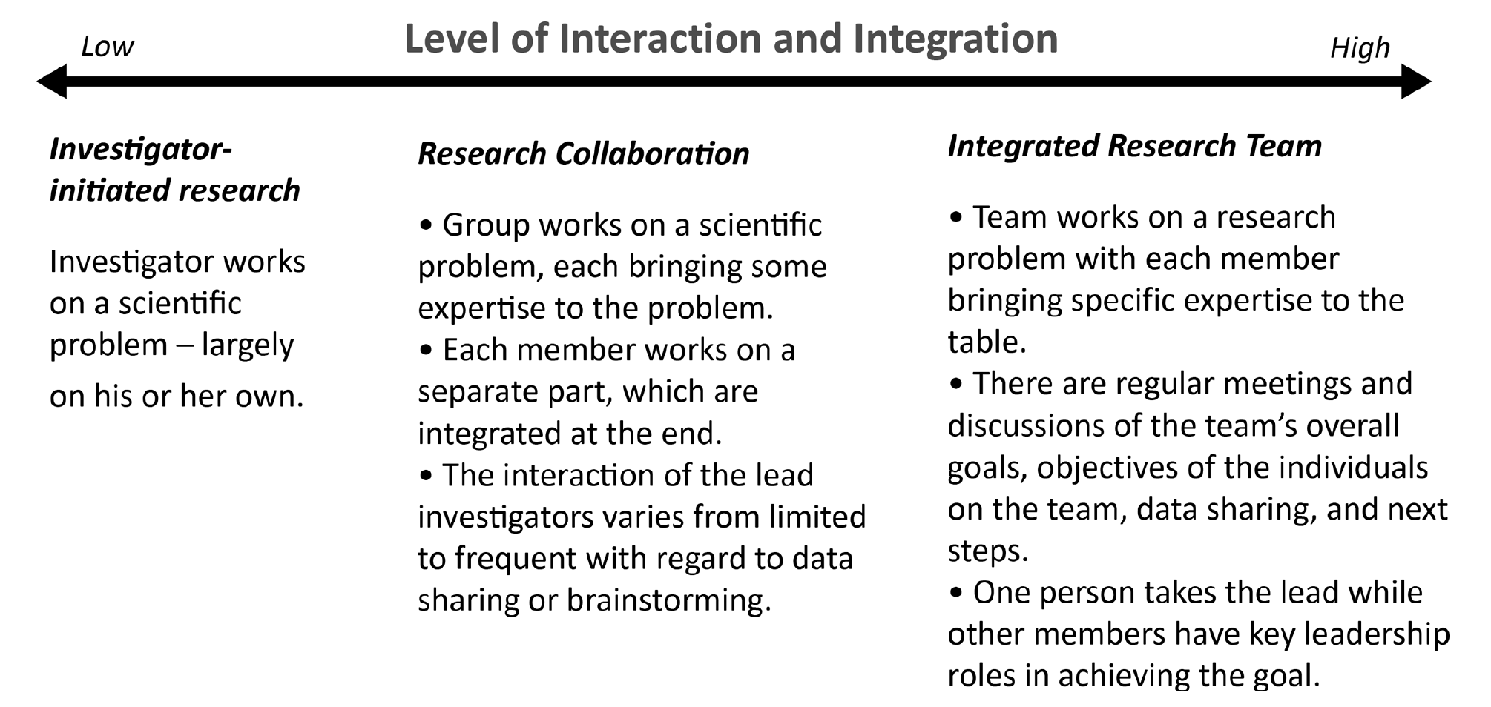
A broad definition of scientific collaboration
Bennett and Gadlin 2012
Notes:
There’s a spectrum in the level of interaction and integration.
No need to restrict our discussion at certain level of collaboration.

